Slide 1
USO INTERNO
Responsible (use of) AI by design
Dr. Richard Benjamins
Chief AI & Data Strategist, Telefonica
@vrbenjamins
Sept 2020

Slide 2
Overview
Context and motivation
The business opportunity for AI
Unintended negative consequences of AI
Proliferation of AI Principles
The challenges for organizations
How to “select” AI Principles?
How to implement the selected AI Principles?
Conclusions

Slide 3
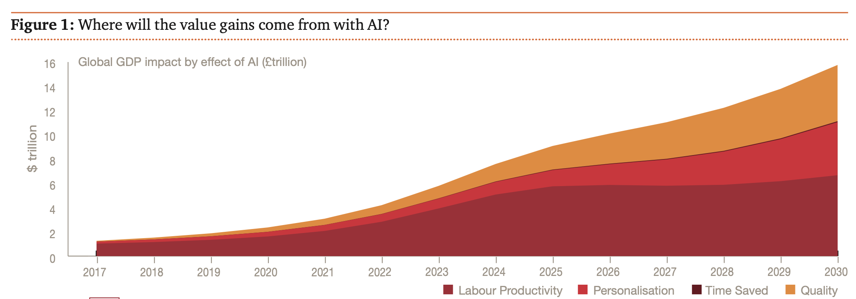
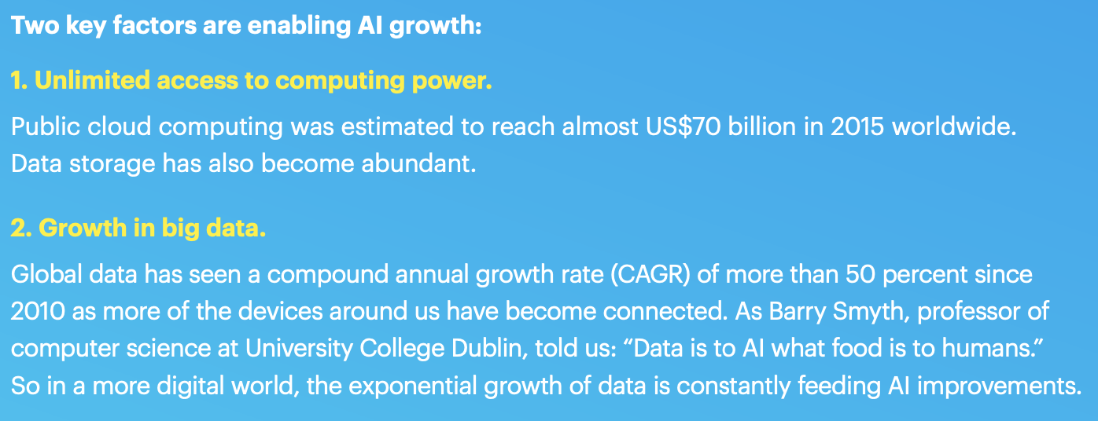
Artificial Intelligence creates enormous business opportunities
Why is AI so successful today?

Slide 4
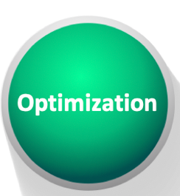
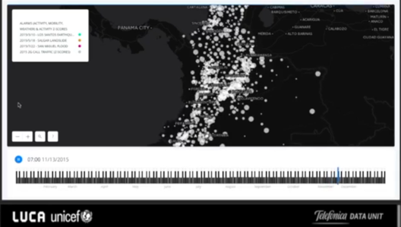
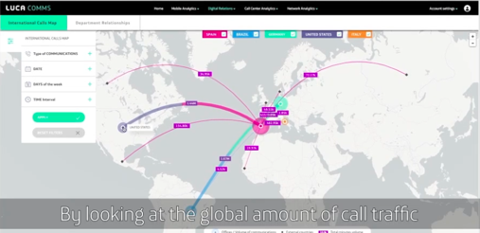
Significant uptake of AI and Big Data in the telco industry
Internal usage
Customer-facing AI
Data & AI for Good
Data insights as a business

Slide 5
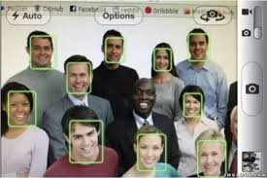
There are also ethical and societal risks associated to AI
Google Translate
Explainability

Slide 6
EC’s Guidelines for Trustworthy AI

Slide 7
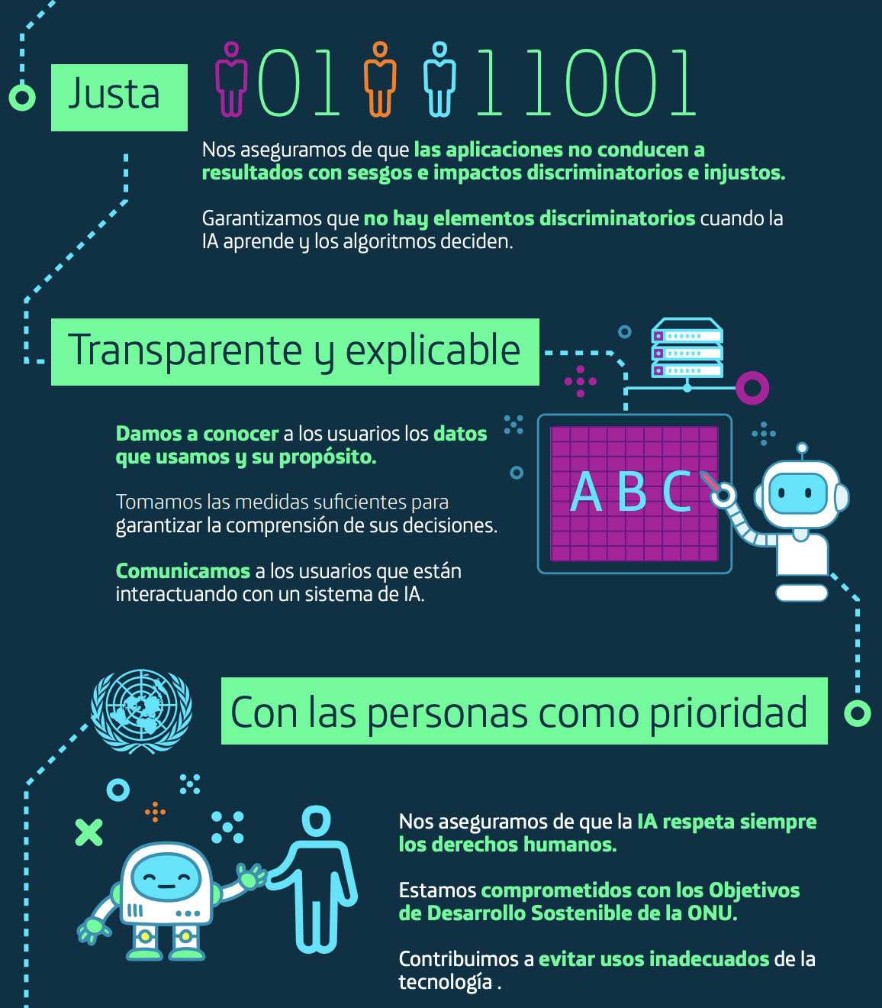
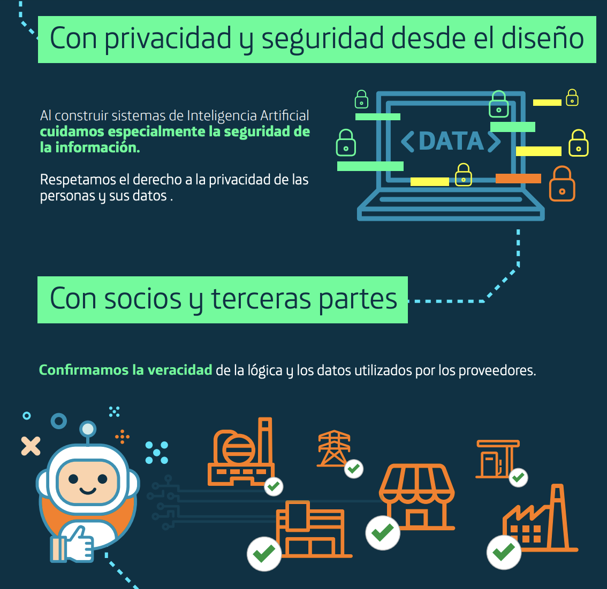
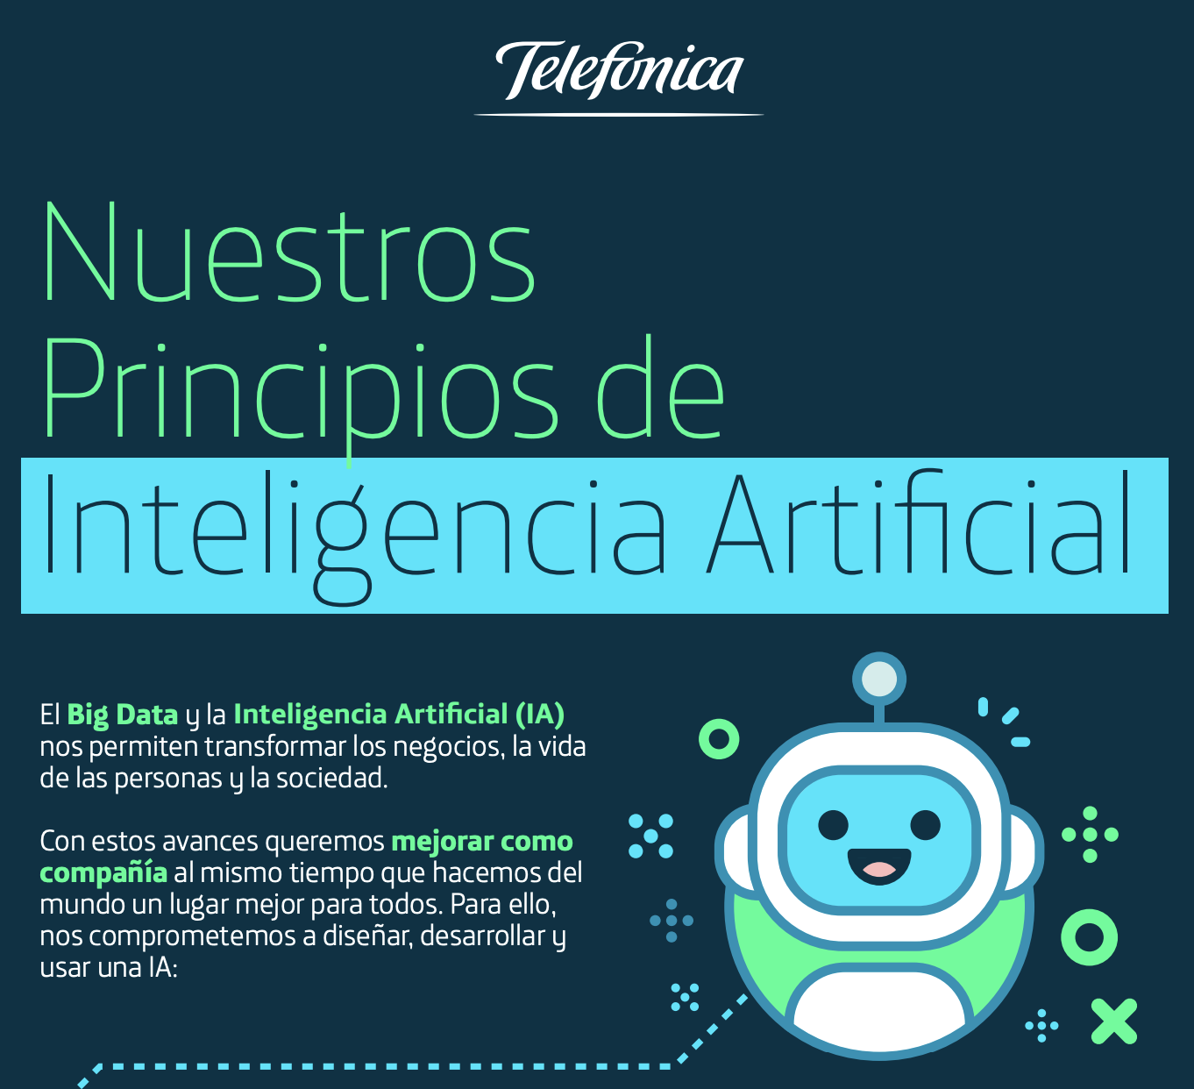
Telefonica’s AI Principles

Slide 8
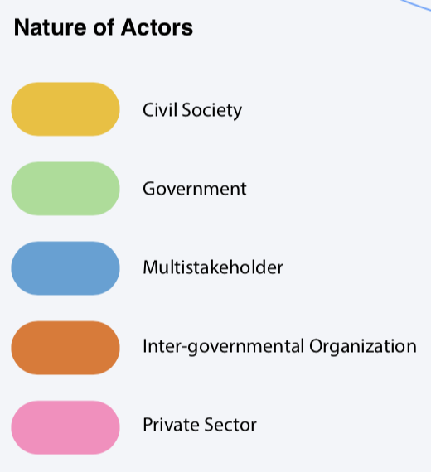
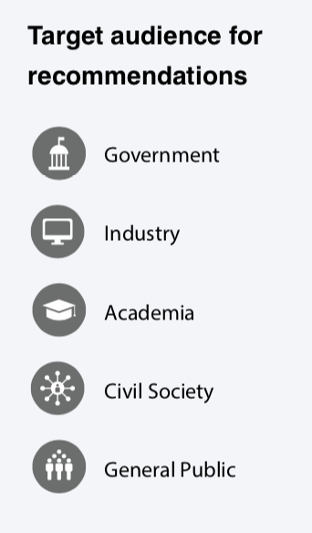
Proliferation of AI Principles
Fuente: Harvard
https://ai-hr.cyber.harvard.edu/images/primp-viz.pdf
@vrbenjamins

Slide 9
Overview
Context and motivation
The business opportunity for AI
Unintended negative consequences of AI
Proliferation of AI Principles
The challenges for organizations
How to “select” AI Principles?
How to implement the selected AI Principles?
Conclusions

Slide 10
Companies are overwhelmed
Lethal Autonomous Weapon Systems
Future of work
Human values
Human rights
Accountability
Transparency & explainability
Human agency (control)
Societal & environmental well-being
Relation people-robots
Privacy
Security
Data governance
Super intelligence
Robustness & safety
Fairness &
non-discrimination
Liability of self-learning autonomous systems
Malicious uses
Concentration of power & wealth
Fake news
AI for Good

Slide 11
Divide and conquer - I
Lethal Autonomous
Weapon Systems
Human values
Human rights
Future of work
Accountability
Malicious uses
Transparency & explainability
Organizations
Governments
Human agency (control)
Societal & environmental well-being
Privacy
Security
Relation people-robots
Liability of self-learning autonomous systems
Robustness & safety
Fairness &
non-discrimination
Super intelligence
Data governance
Concentration of power & wealth
AI for Good
Fake news

Slide 12
Divide and conquer - II
Unintended
Lethal Autonomous
Weapon Systems
Human values
Human rights
Future of work
Governments
Accountability
Societal & environmental well-being
Transparency & explainability
Human agency (control)
Relation people-robots
Organizations
Security
Liability of self-learning autonomous systems
Privacy
Robustness & safety
Concentration of power & wealth
Data governance
Fairness &
non-discrimination
Fake news
Intended
AI for Good
Malicious uses

Slide 13
Focus for organizations to ensure ethical use of AI
Human values
Unintended
Human rights
Accountability
Transparency & explainability
Human agency (control)
Organizations
Security
Privacy
Robustness & safety
Data governance
Fairness &
non-discrimination

Slide 14
End-to-end approach versus AI-specific approach
End-to-end
Accountability
Transparency & explainability
Human rights
Human values
Human agency (control)
AI-specific
Privacy
Security
Robustness & safety
Fairness &
non-discrimination
Some general risks are increased by AI
Data governance

Slide 15
Overview
Context and motivation
The business opportunity for AI
Unintended negative consequences of AI
Proliferation of AI Principles
The challenges for organizations
How to “select” AI Principles?
How to implement the selected AI Principles?
Conclusions

Slide 16
Implementing AI Principles through the Responsible AI by Design methodology
Components of Responsible AI by Design
Principles
Awareness, training
Questionnaire with recommendations
Tools
Governance model

Slide 17
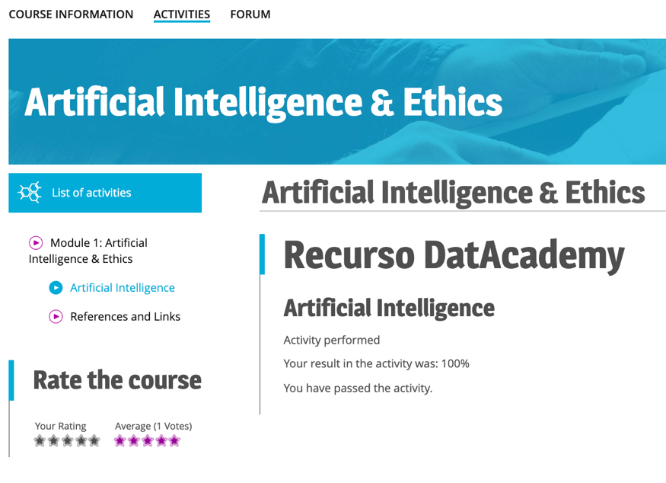
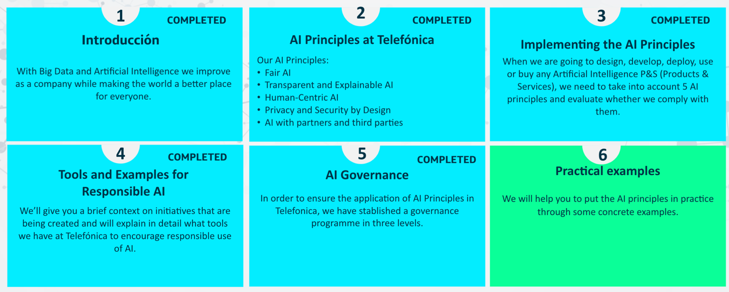
Online course for employees
Content depends on role in the organization:
Responsible AI Champion
Product owner
Business development Big Data & AI
Technical data professional
General profile

Slide 18
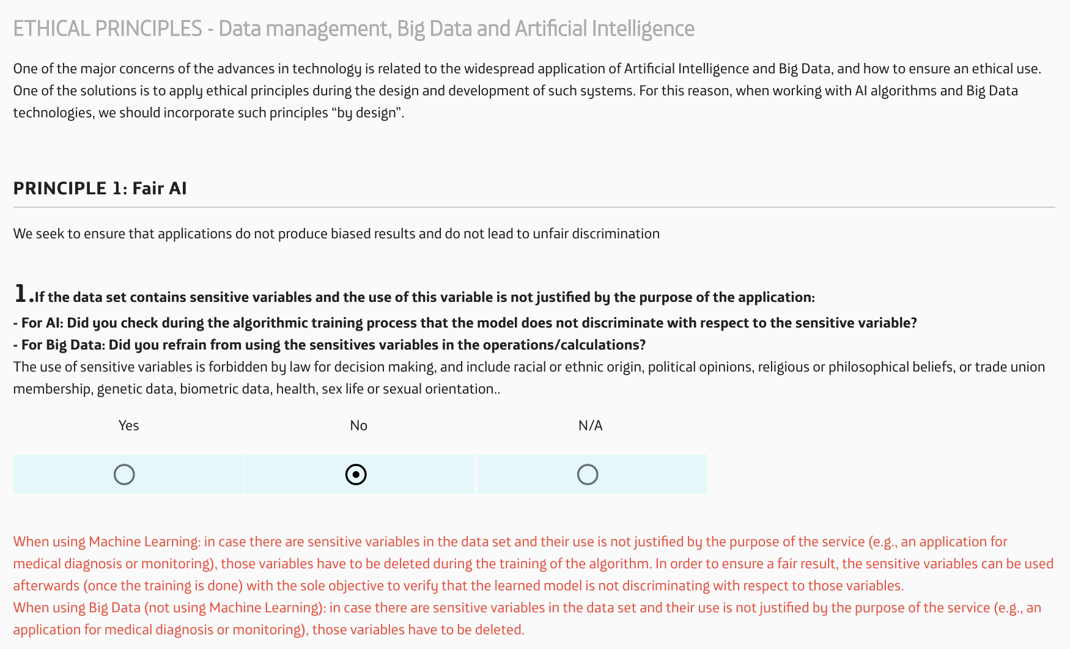
Questionnaire for AI assessment

Slide 19
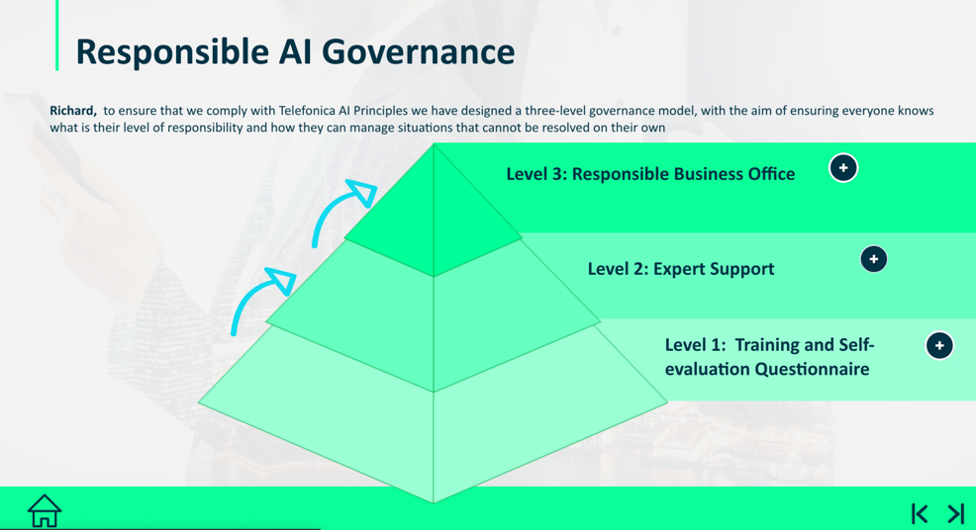
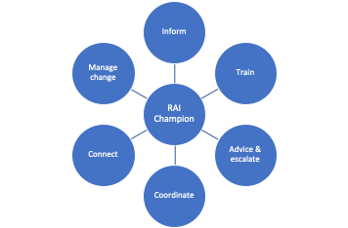
Governance
A new organizational role: the RAI Champion
Questionnaire

Slide 20
Conclusion
What AI Principles to select?
Select those AI principles that you can act on
Select the AI principles fit for your sector
Decide whether you want end-to-end or AI-specific principles
How to implement the AI Principles in an organization
Follow a methodology like “Responsible AI by Design”
Train your employees
Introduce a new role: RAI Champion

